Slide 1
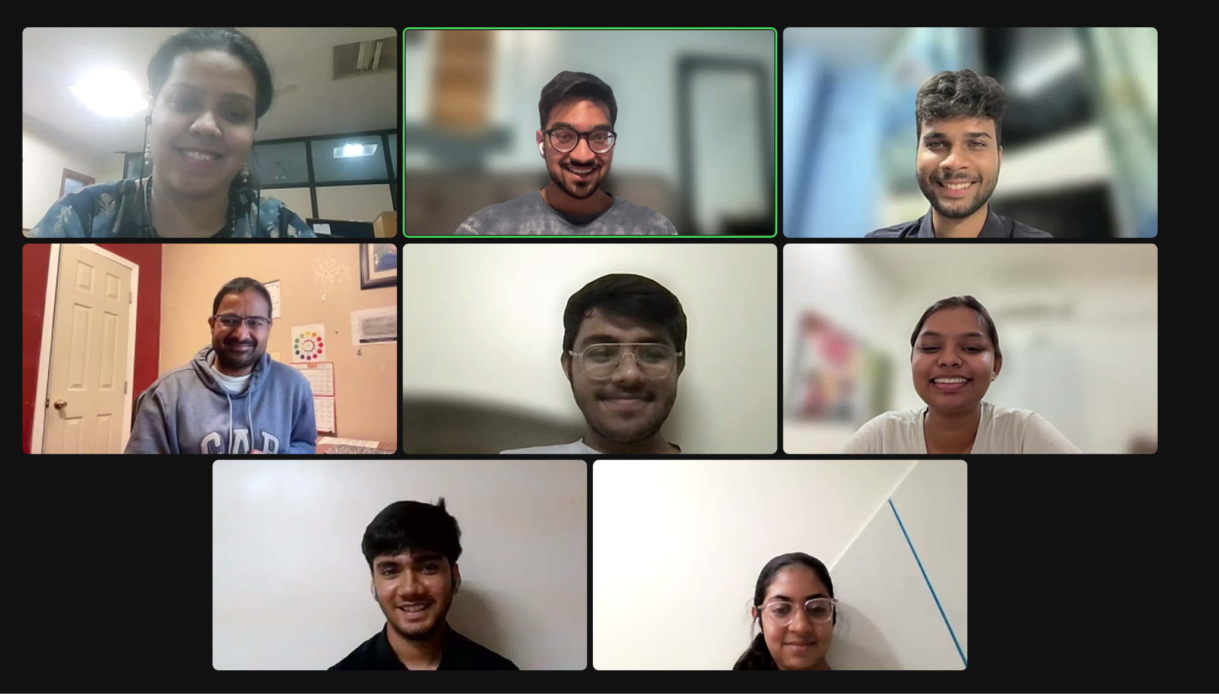
SimPPL
Responsible Computing Fellowships
Dr. Swapneel Mehta, Prof. Pranit Bari
Dwarkadas J. Sanghvi College of Engg.

Slide 2
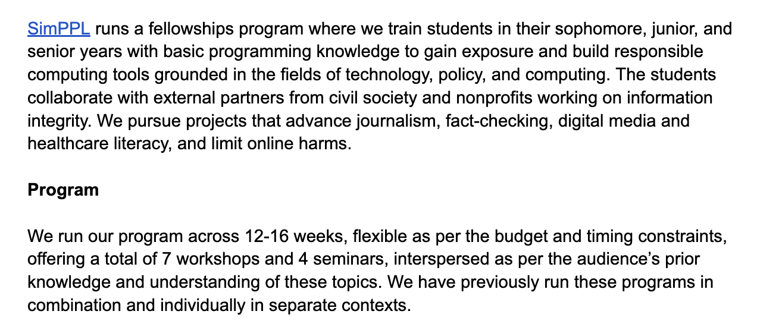
Review the Full Report Below
Read More about the SimPPL Fellowships Program

Slide 3
Motivation: Improve the Accessibility of Research
Many Tier I, Tier II, and Tier III colleges in India don’t have the necessary research infrastructure and faculty to support meaningful research outcomes.
Classroom education is insufficient to engage students; we were a product of the very same ecosystem so we know.
Students pursue a limited set of goals (Ivy League education, job at FAANG company) because they’ve never seen any of the possibilities beyond them!
Responsible Computing
Research Mentorship
Research Infrastructure
Research Partners

Slide 4
Goals for the Program
Improve the accessibility of students to pursue tier-1 research publications
Translate research into practice
Build responsible computing tools from gleaned research insights
Deploy systems to support organizations solve real-world problems
Improve career outcomes for students in the long run
Learning Goals
Write Papers
Build Tools
Lead Partnerships

Slide 5
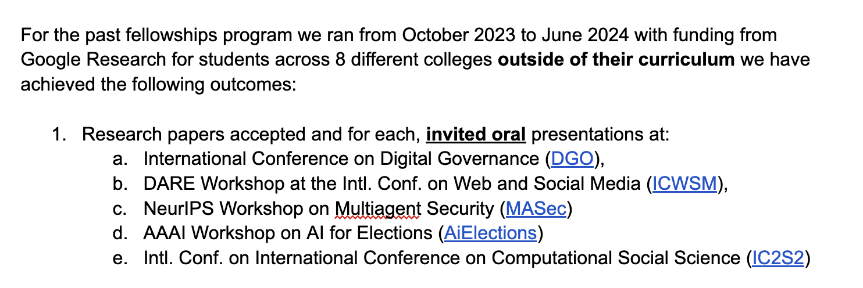
Outcomes Achieved: Publications

Slide 6
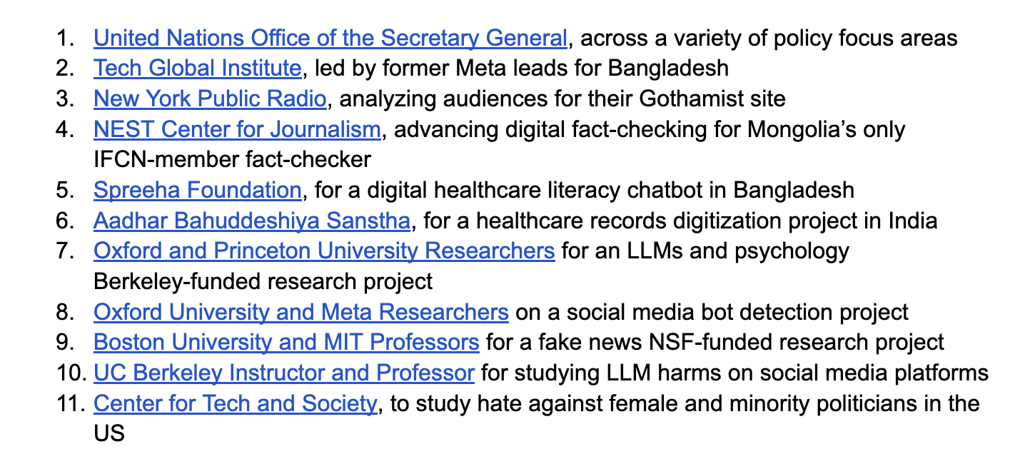
Outcomes Achieved: Partnerships

Slide 7
How did we do it?
Invest in students and provide the best support possible regardless of outcomes.

Slide 8
Recruiting through multiple channels
Word of Mouth, WhatsApp, Mailing Lists
Sent out messages through undergraduates in college WhatsApp groups.
Used our networks on LinkedIn, Twitter, Mailing Lists focused on India, AI/ML.
Word of mouth was the strongest signal for recruiting.
Talk to teachers, deans, principals, heads of dept.
Week 0
92 applicants
(closed form)
Week 4
Week 10
65 interviewed
Week 12
42 candidates selected
Week 30
12 completed projects

Slide 9
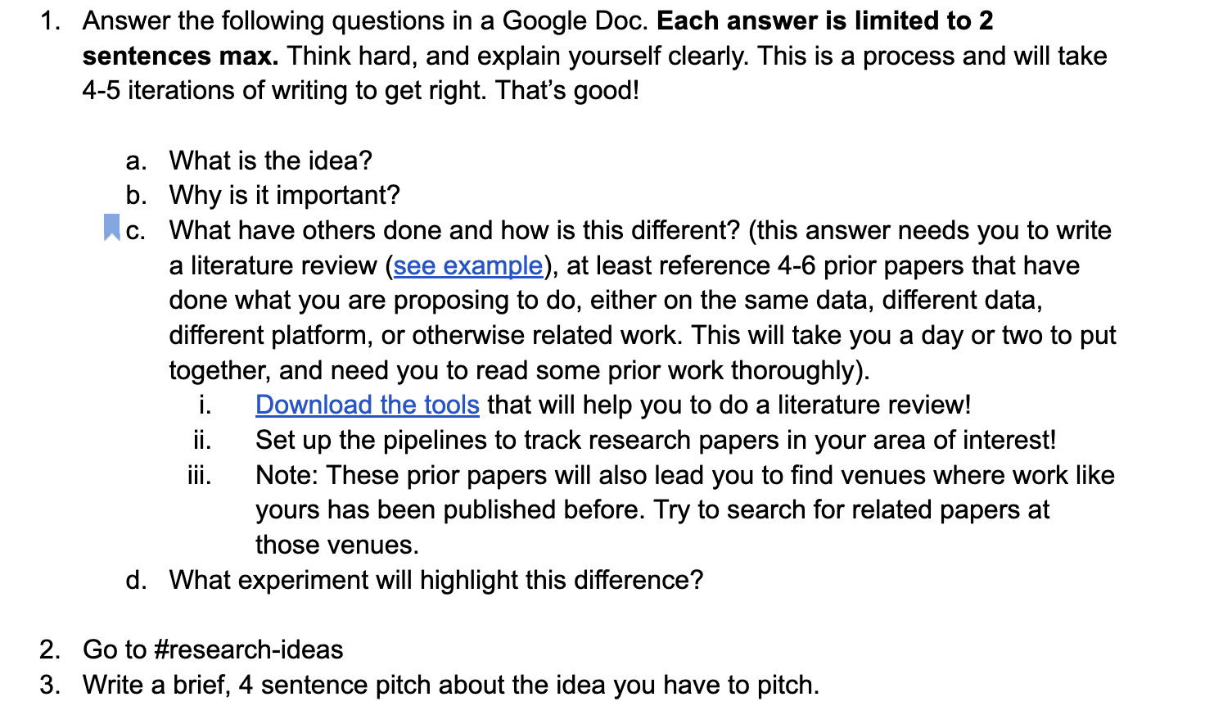
Defining Projects and Scoping out Proposals Thoroughly
Sample Literature Review

Slide 10
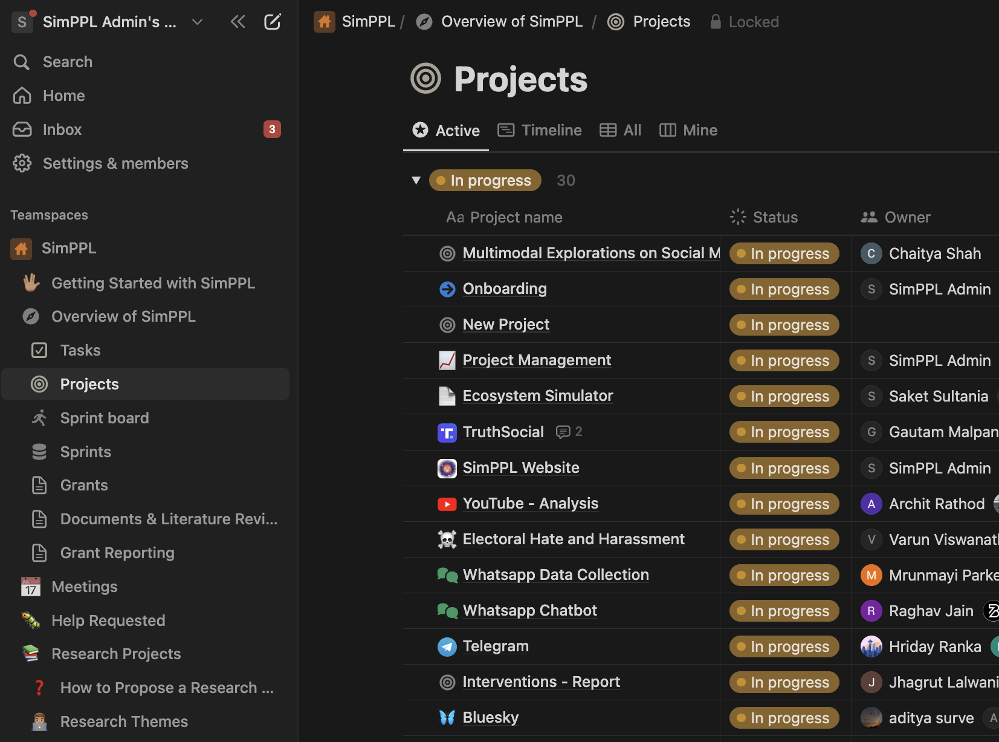
“Frontloading” Mentorship
Mentors are not just people who have to issue guidance, they have to solve problems (at least early on).
Mentors will lay out very concrete tasks for students to complete (early on).
Mentors need to check in frequently, and make time for ad hoc discussions.
Mentors need to flag literature and identify a direction that is aligned with student interests!
Failure is a mentor’s responsibility while success is a student’s win.

Slide 11
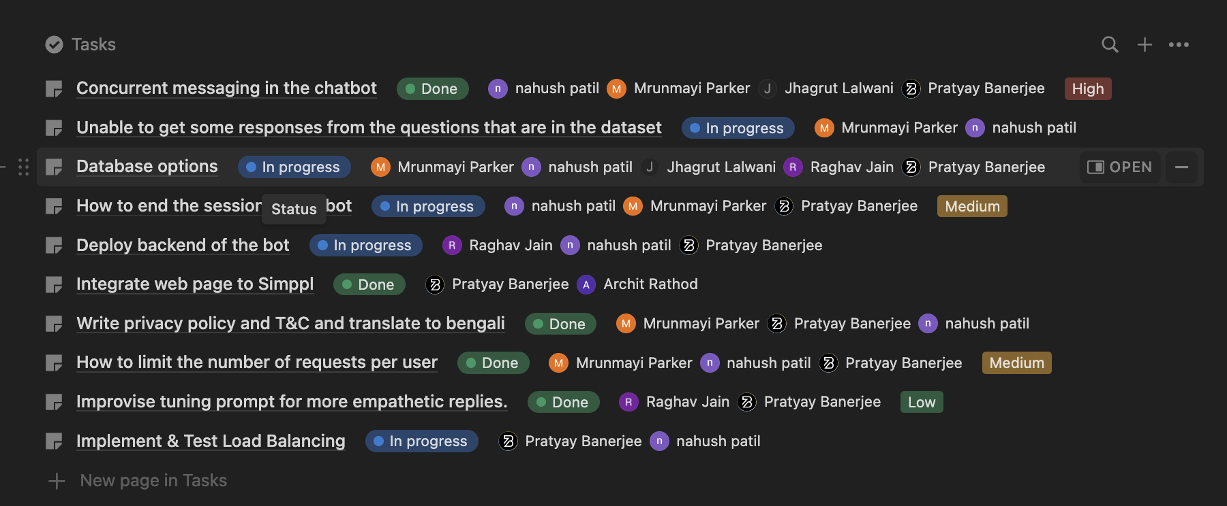
Good Mentors should excel at Project Management

Slide 12
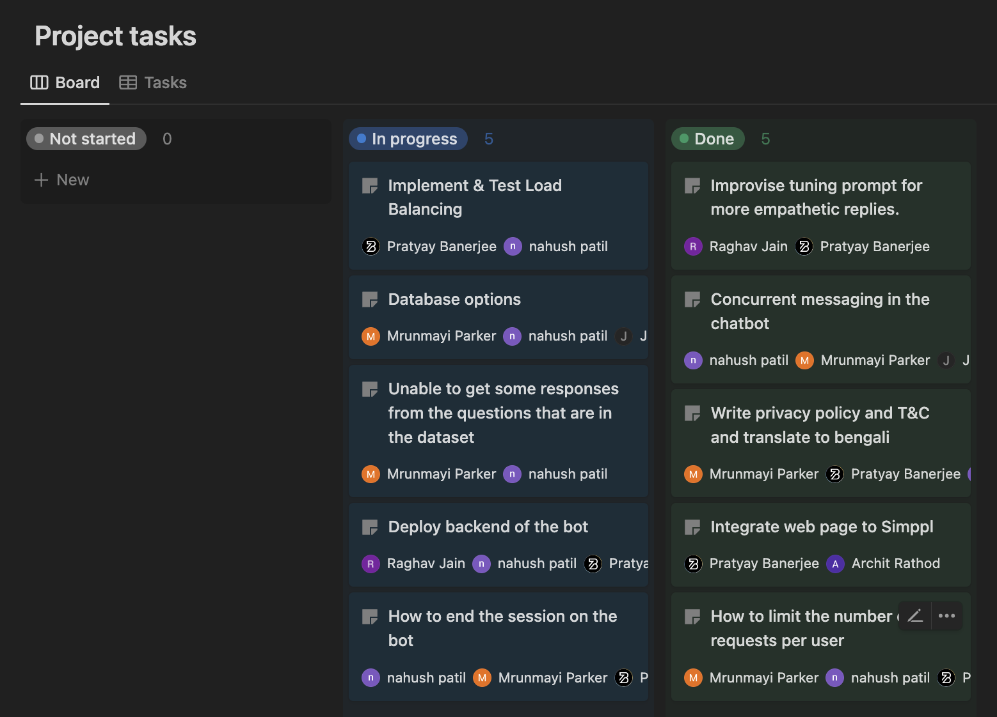
Because PM → Accountability → Timely Completion of Projects
Mentor should learn how to carve out independent subtasks.
List out resources for students to follow-up and read about.
Track due dates and completion dates to establish transparent accountability
Try different models for projects:
Data tells you the story for your work
Research hypothesis comes from you
Find a partner who tells you what to do?

Slide 13
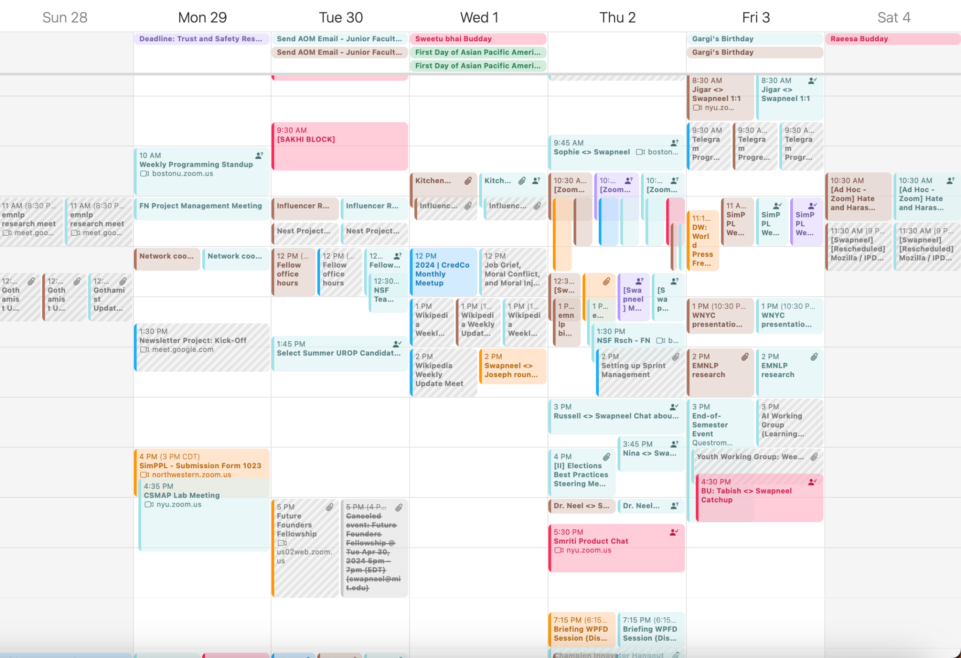
It’s a heck of a lot of work to lead by example…
You need to make time for your students to teach them to make time for others. Building culture is hard, but is mission-critical!

Slide 14
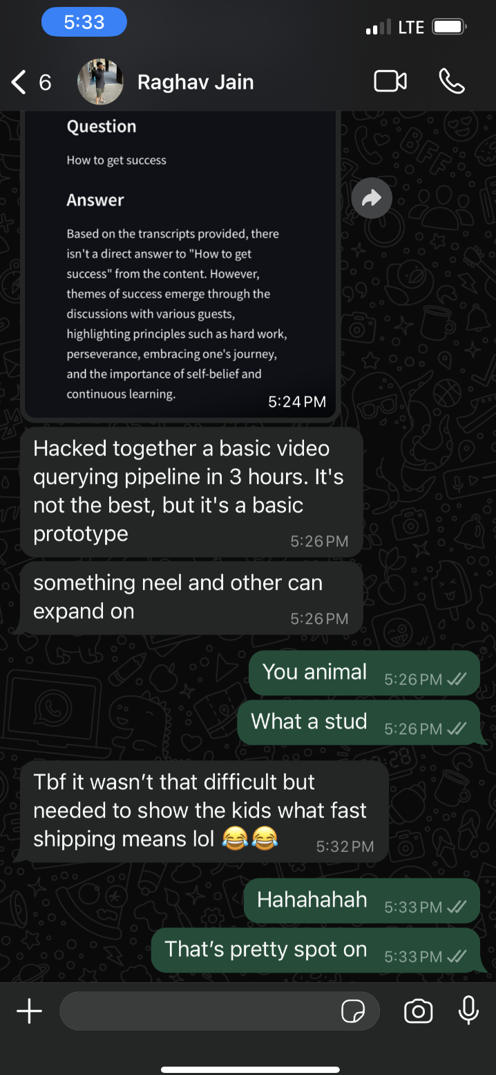
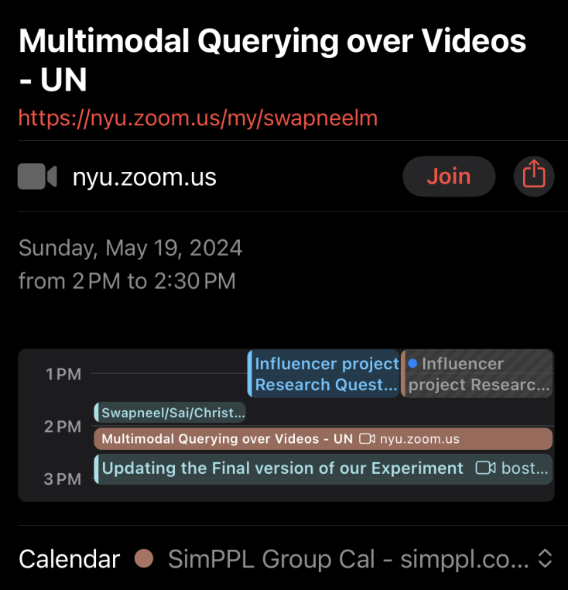
…but it is totally worth it when it works out!
2:30 pm Had a call about building multimodal querying for video analysis.
5:30 pm Prototype hosted, tested, and deployed!

Slide 15
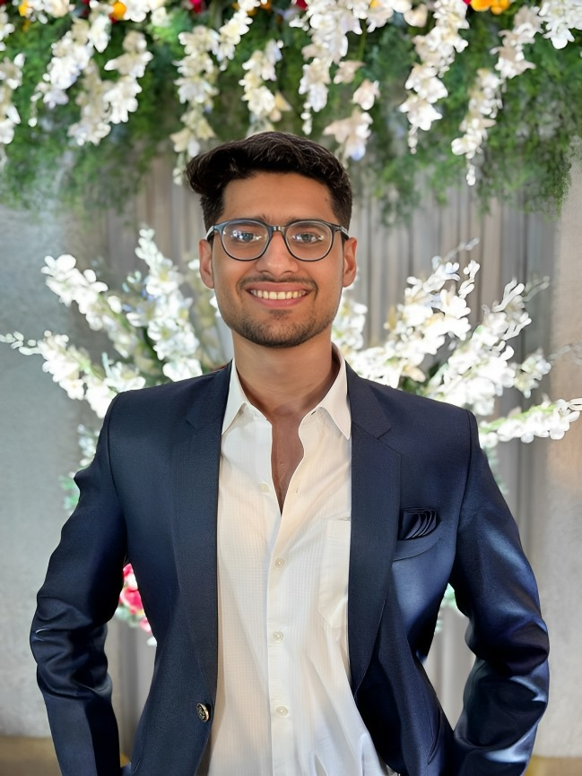
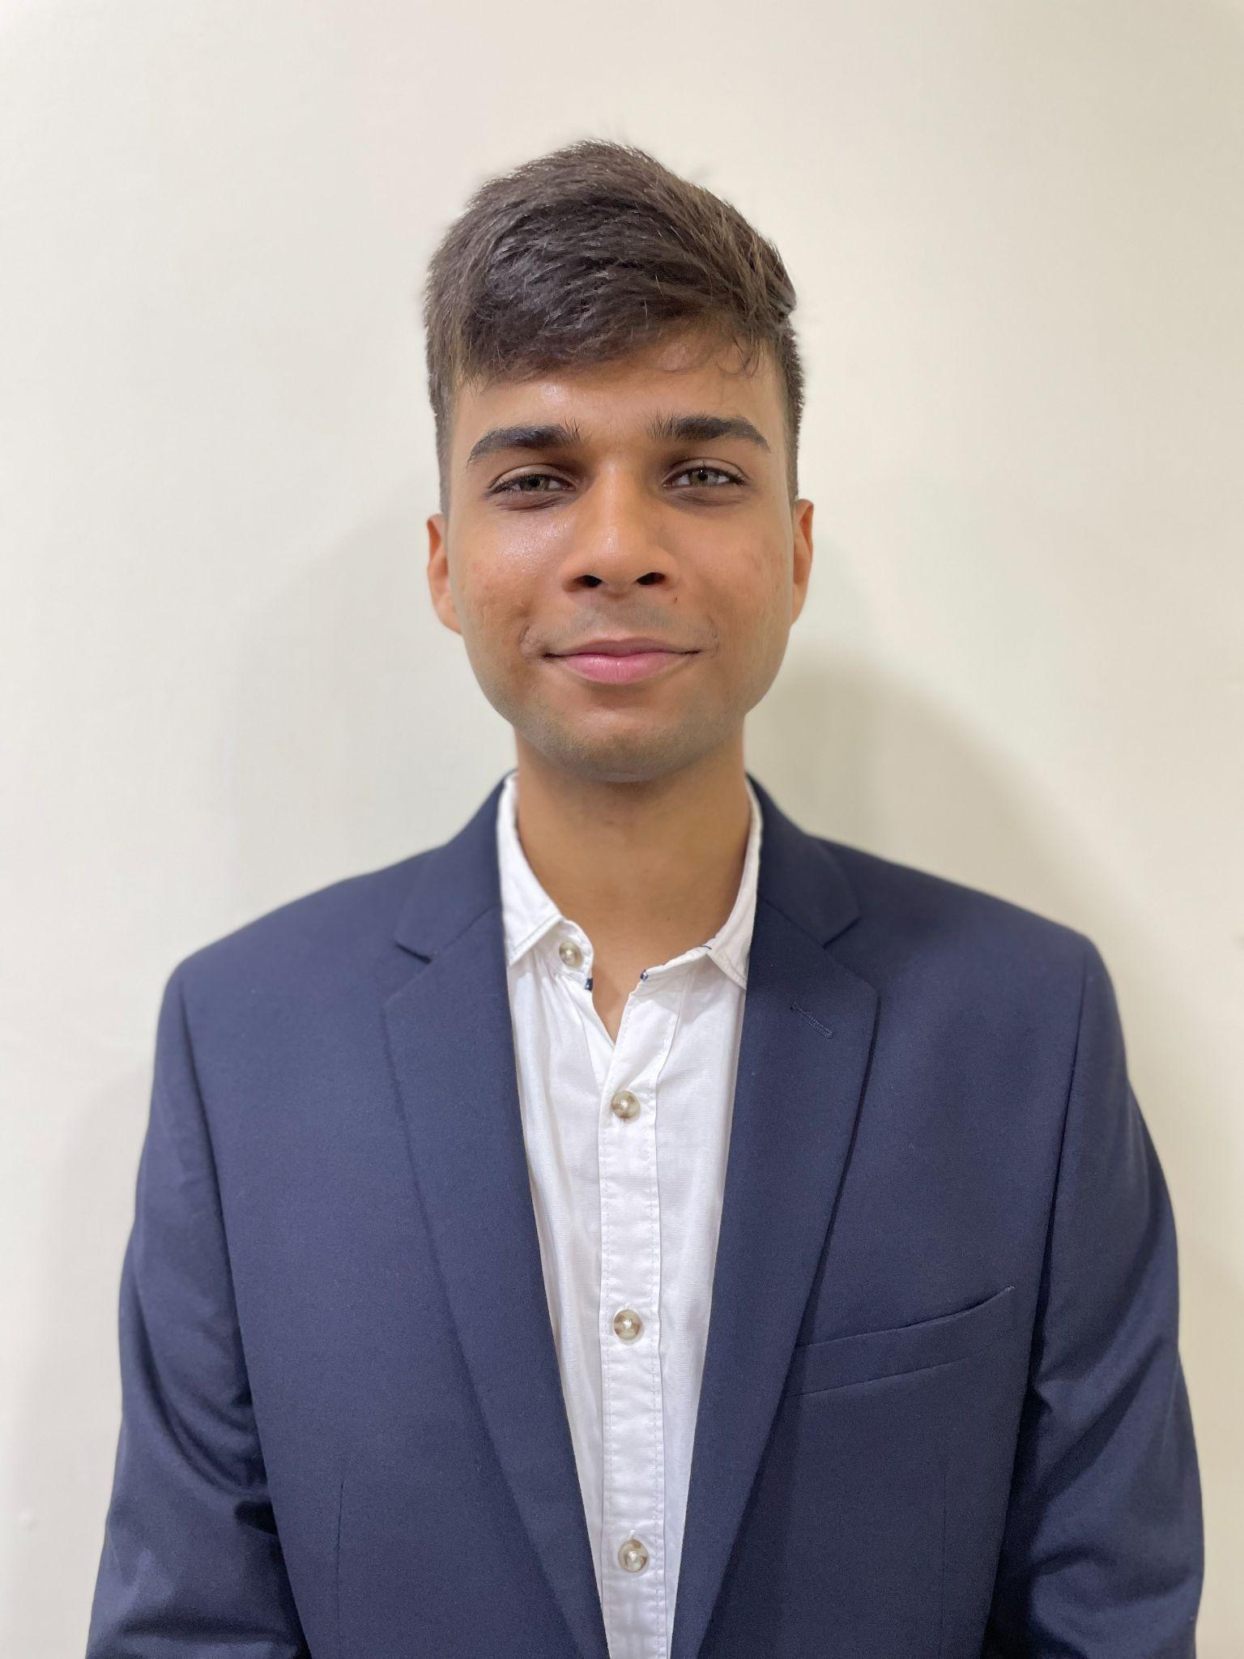
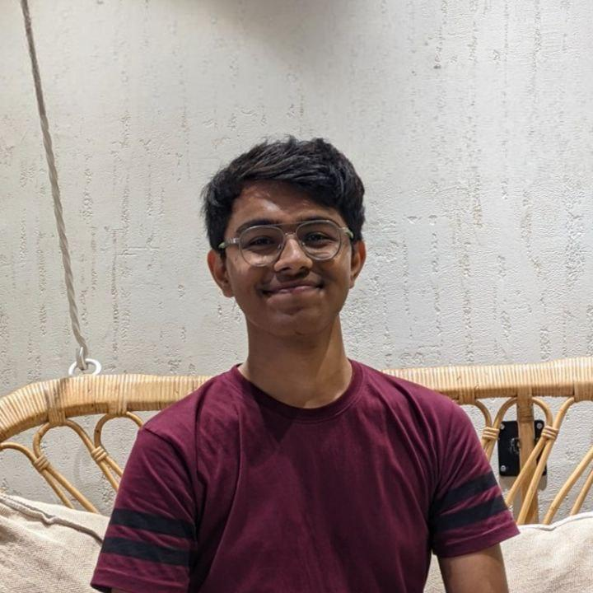
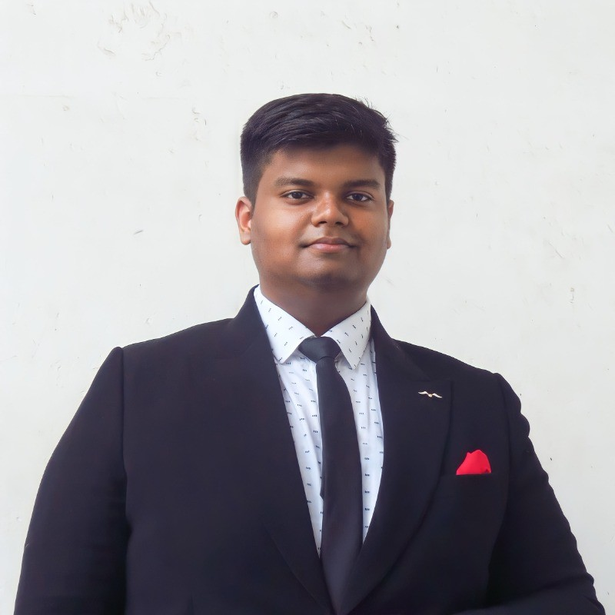
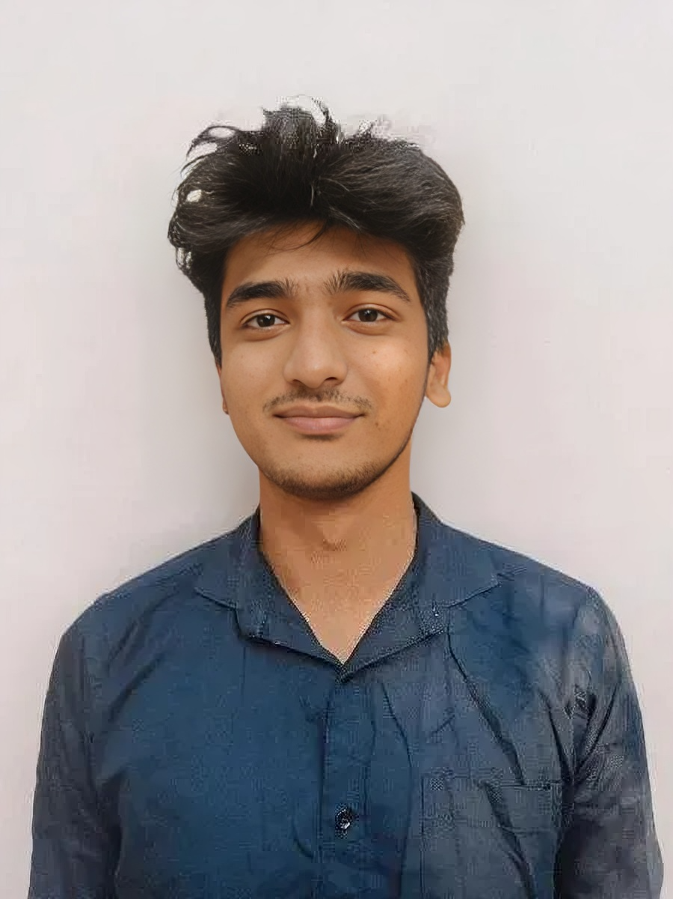
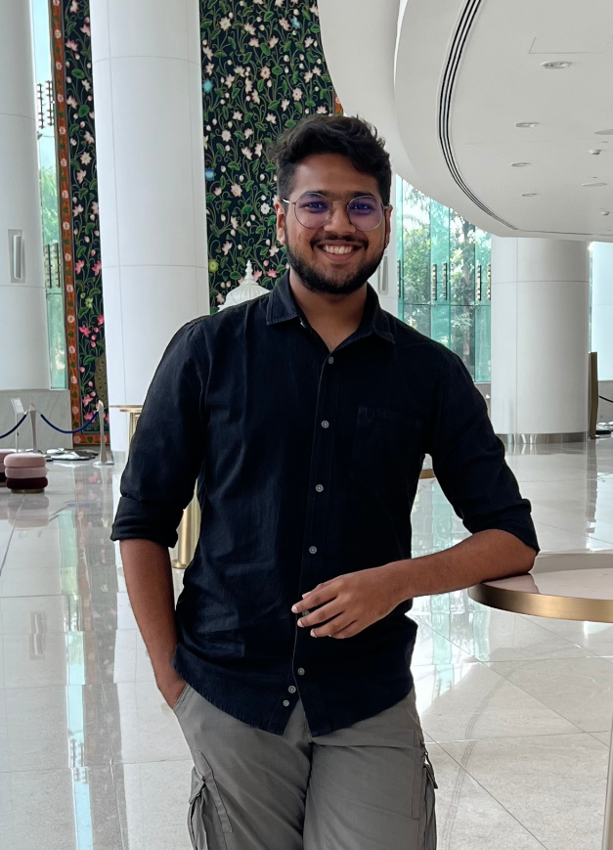
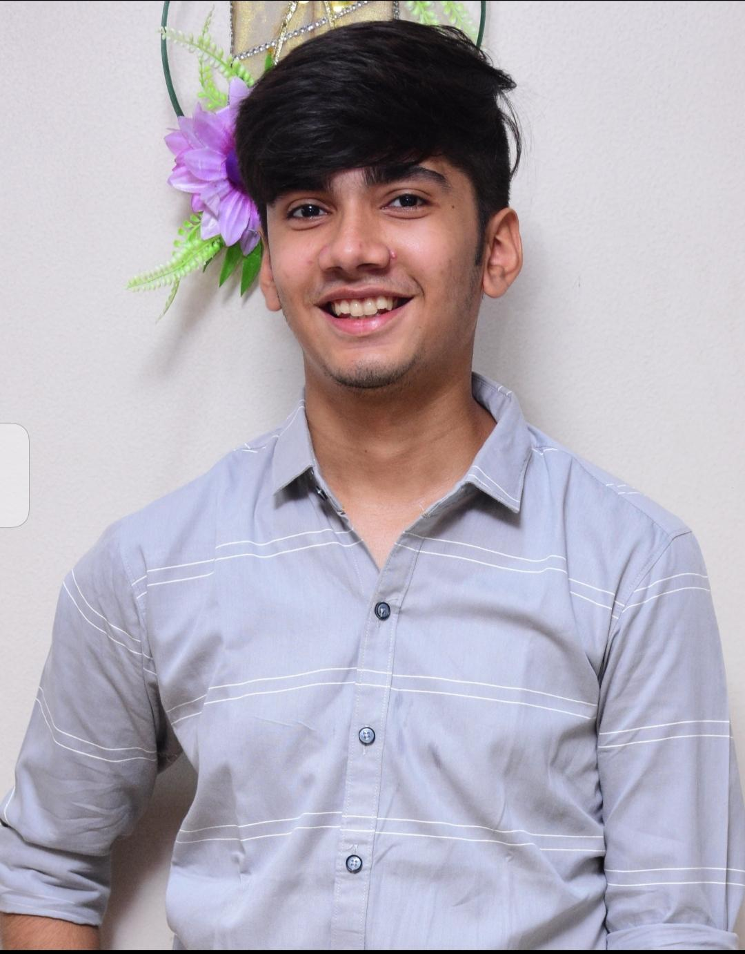
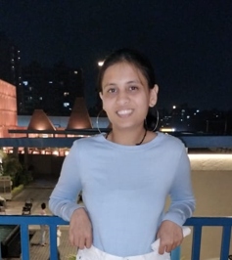
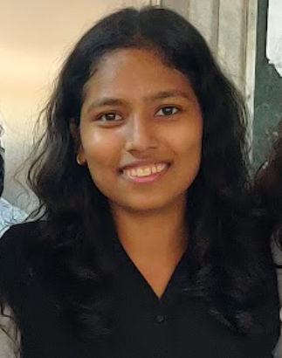
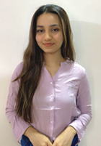
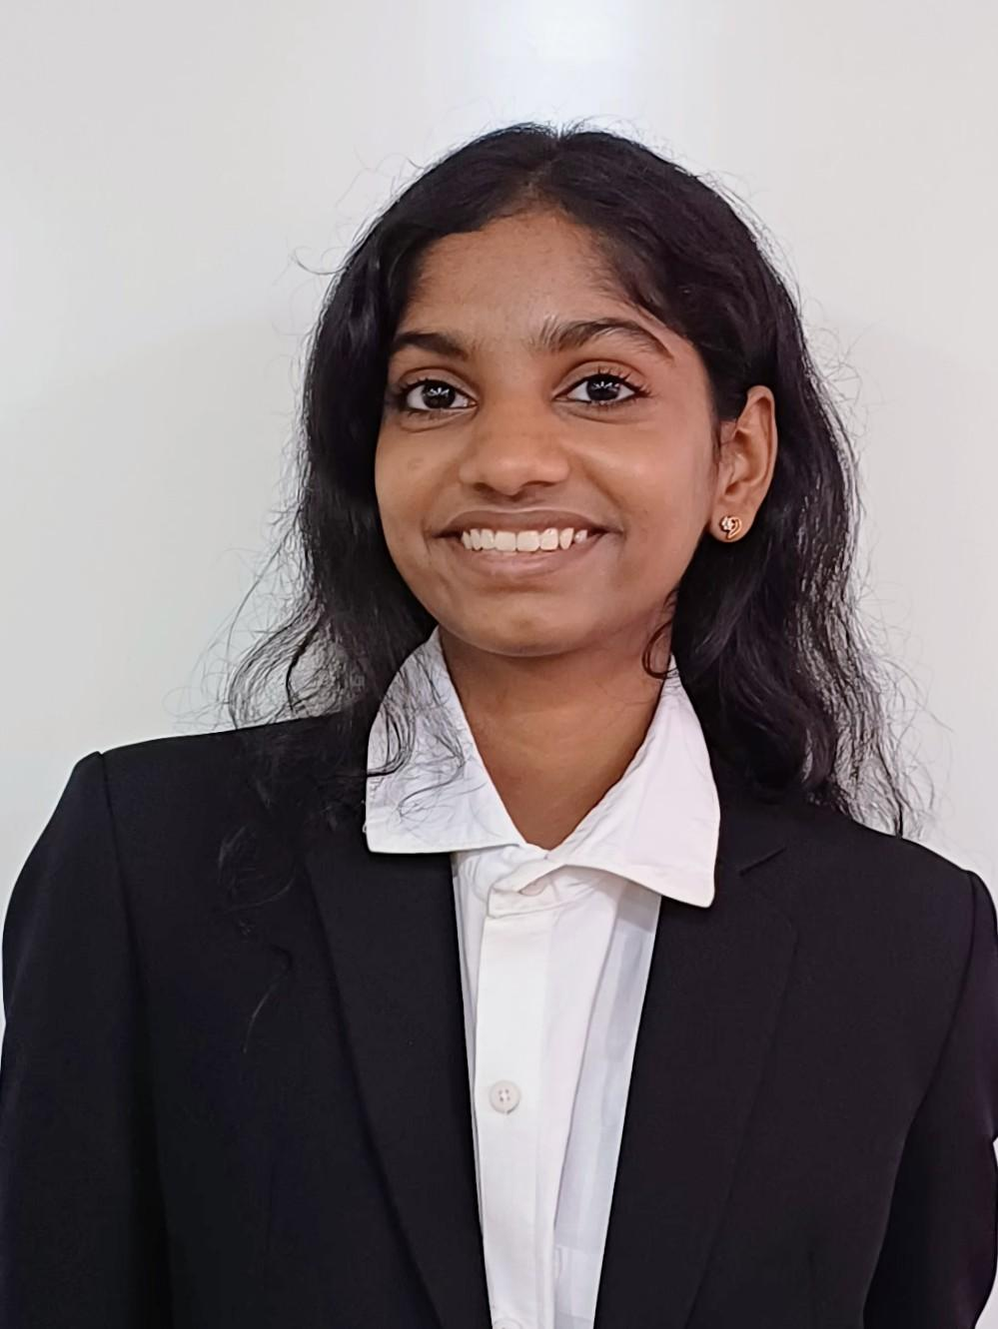
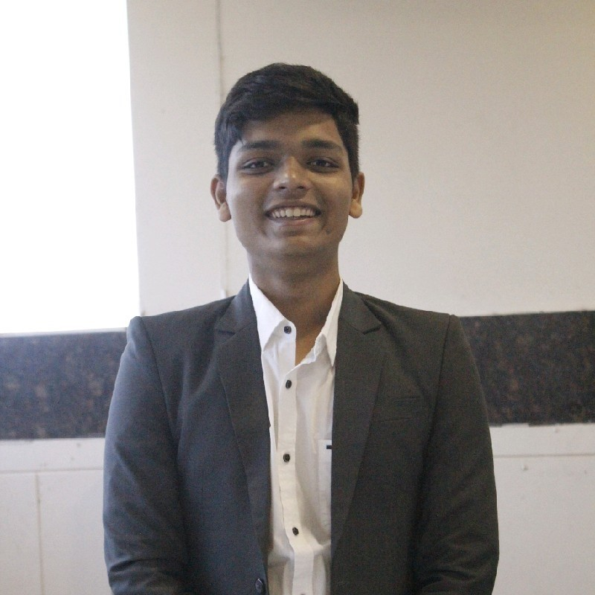
(Some of our) Fellows
Mohammed Raza Syed 4th Year, Comp. Engg. D.J. Sanghvi
Aaryamonvikram Singh B.E. AI and DS TSEC
Abhigyan Bafna 3rd Year,. I.T TSEC
Saket Sultania 4th Year, CE MPSTME
Ritesh Konka 3rd Year, AI&ML D.J. Sanghvi
Dev Bhut 3rd Year, Comp. Engg. D.J. Sanghvi
Naman Surana 2nd Year, IT. Engg. D.J. Sanghvi
Margi Yadav
3rd Year ICT Engg.
PDEU
Meetali Kapse 3rd Year, I.T. TSEC
Pankti Sheta 4th Year, CSE GCET
Shristi Shetty 3rd Year AI & DS TSEC
Siddh Shah B.E. IT TSEC, Mumbai

Slide 16
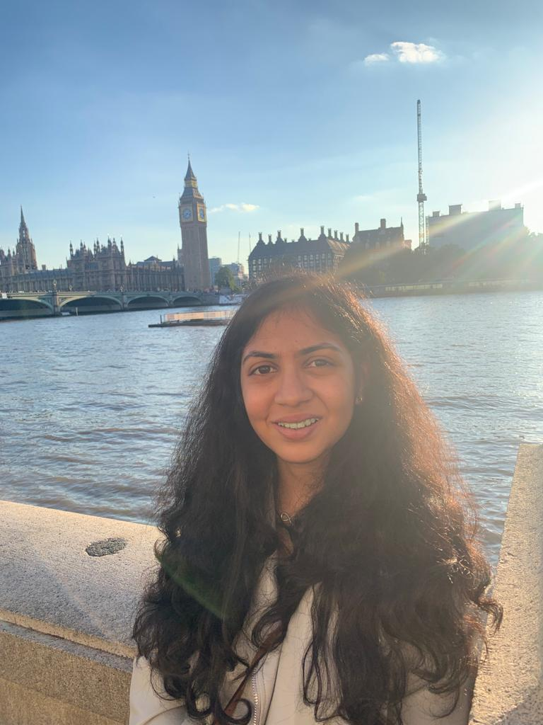
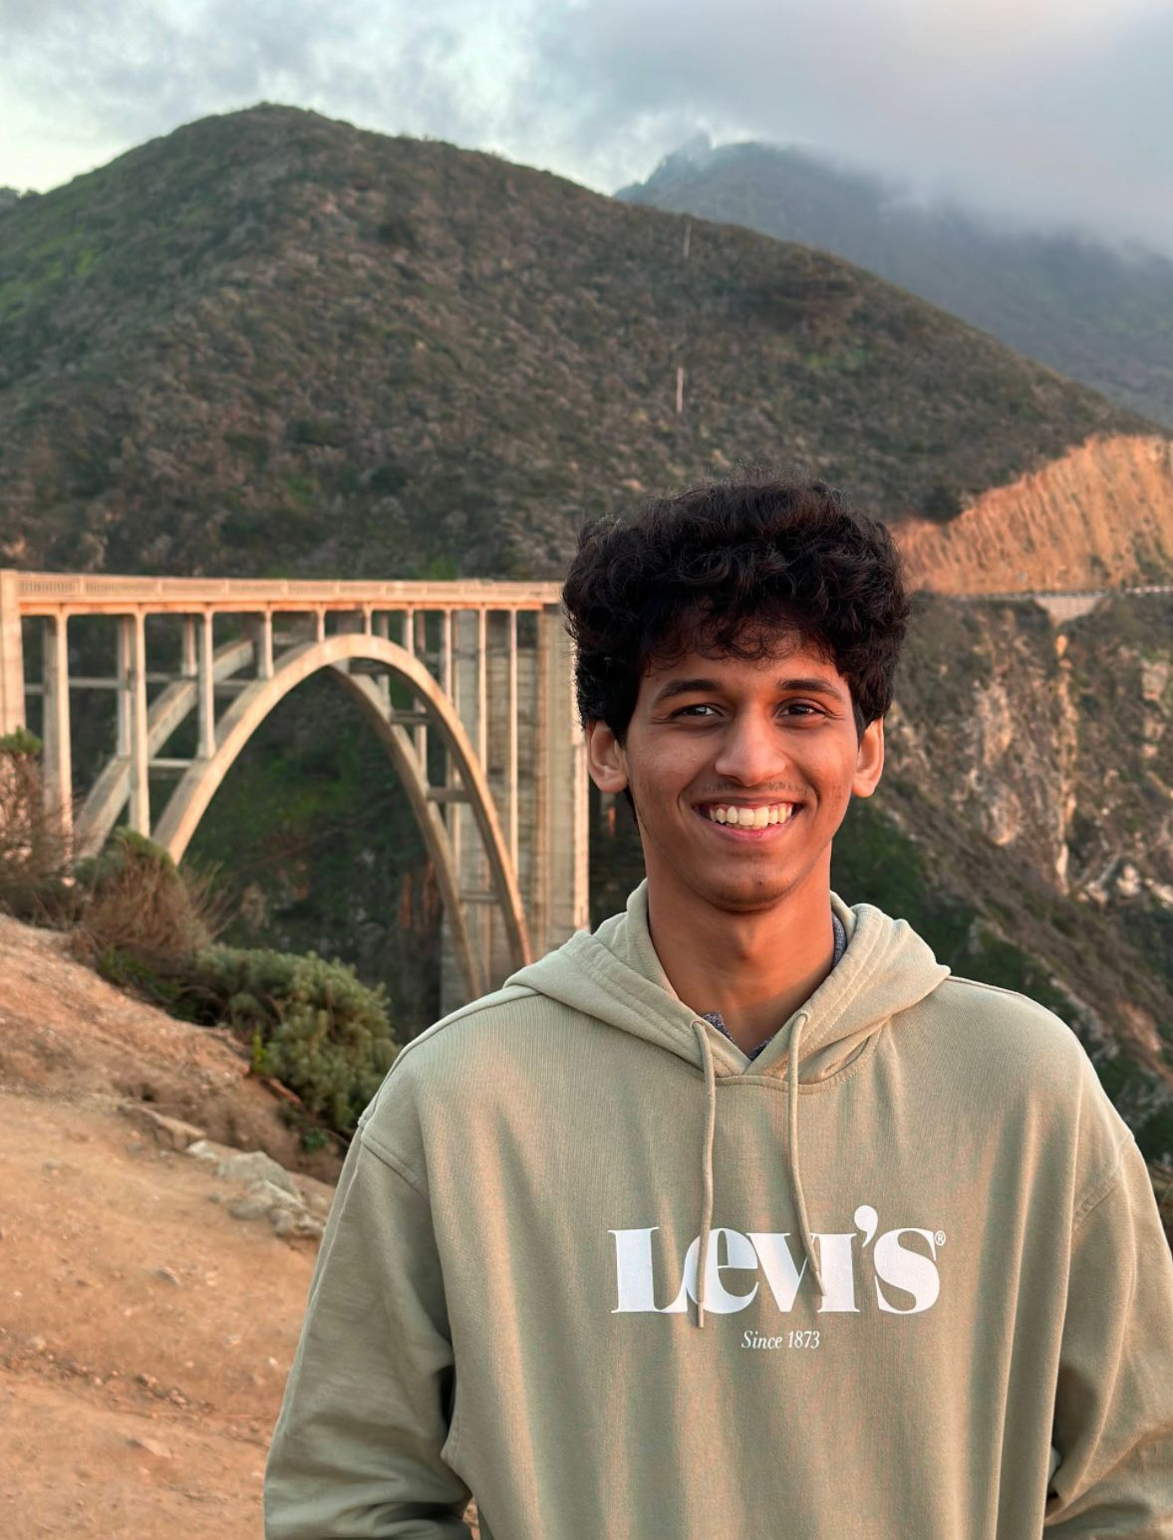
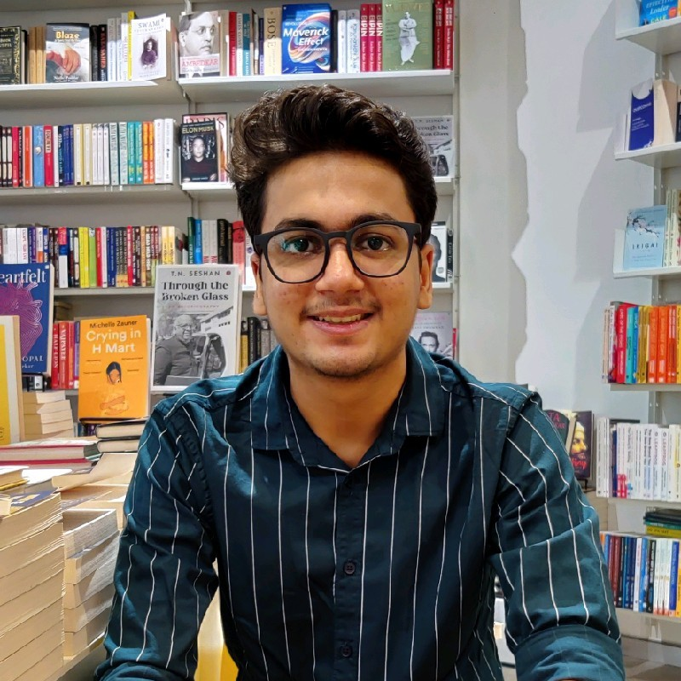
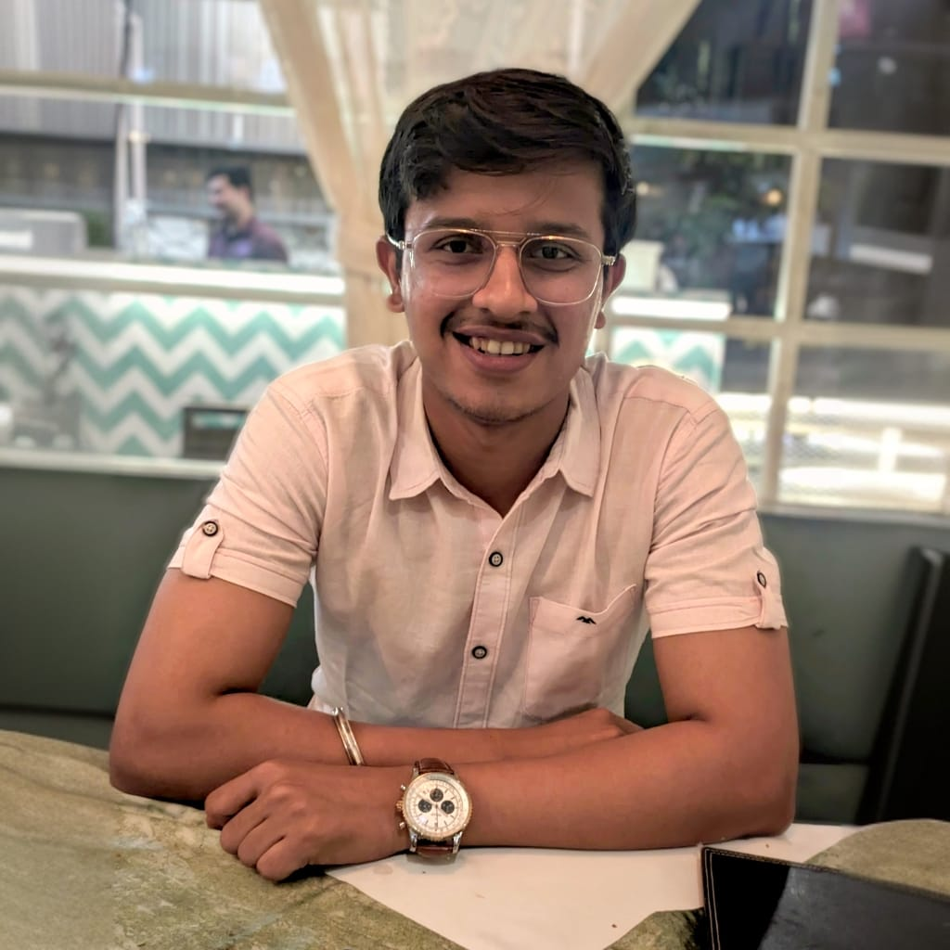
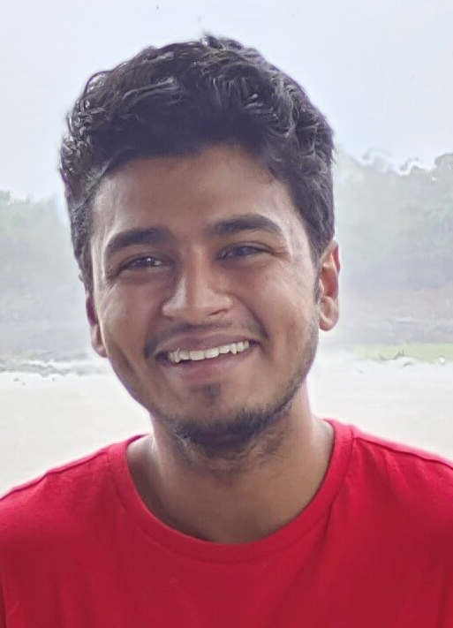
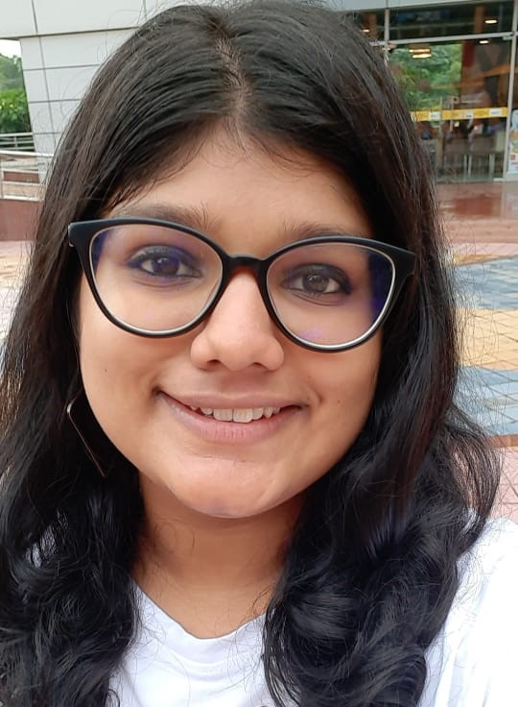
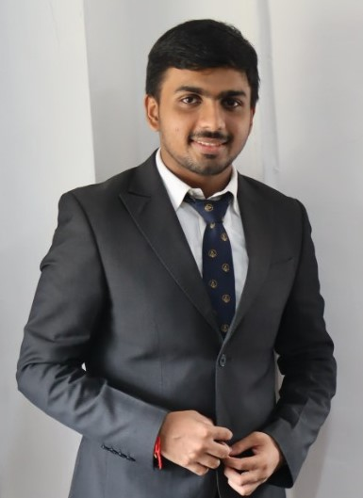
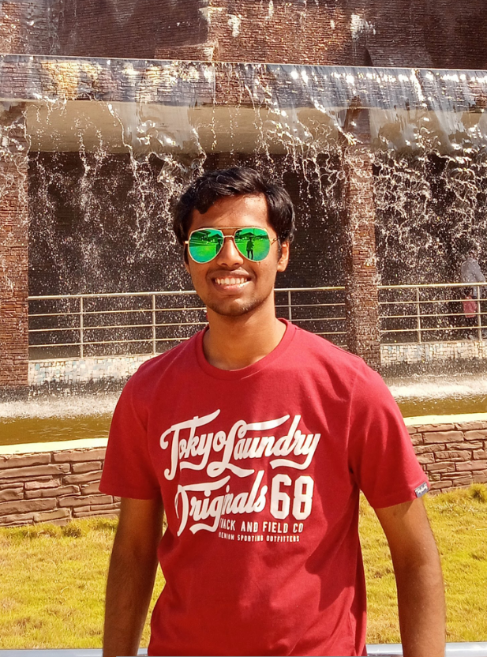
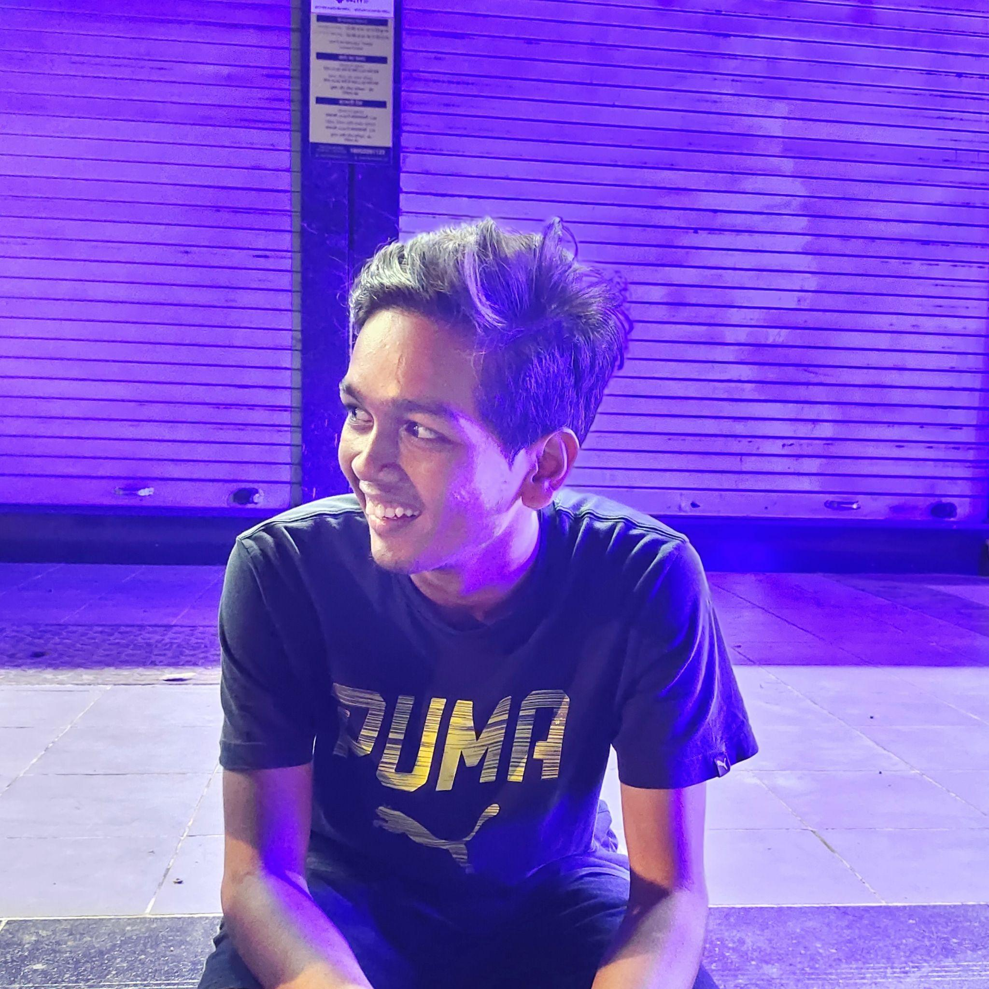
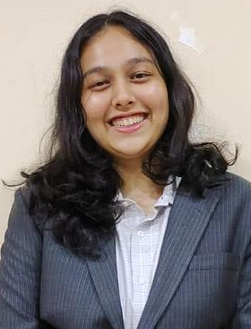
(Some of our) Mentors
Dhvani Shah 2nd Year, IT. Engg. D.J. Sanghvi
Vedant Pradhan
3rd Year AI & DS
DJ Sanghvi
Chaitya Shah 3rd Year, Comp Engg. DJSCE, Mumbai
Mokshit Surana 4th Year, IT Engg. TSEC, Mumbai.
Nahush Patil 4th Year, IT Engg. TSEC, Mumbai.
Mrunmayi Parker 4th Year, IT Engg. TSEC, Mumbai.
Veer Pariawala 4th Year, IT Engg. TSEC, Mumbai
Veer Pariawala 4th Year, IT Engg. TSEC, Mumbai
Gautam Malpani 4th Year, IT Engg. DJSCE, Mumbai
Prasad Ranjane 4th Year, IT Engg. TSEC, Mumbai
Gargi Sathe 4th Year, IT Engg. TSEC, Mumbai

Slide 17












(Some of our) Partners

Slide 18
Challenges
It is very hard to engage with students in a remote-first manner!
Tracking deliverables and ensuring accountability took us very long
Team balance was thrown off by personal commitments
Students wanted to do too much, too quickly. They overloaded themselves out of excitement for cool partnerships and ran out of steam quickly
We tried to allow students to work part-time, pursue internships – bad idea!
Belies a lack of confidence in our program
Incentivizes slacking and deprioritizing team

Slide 19
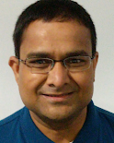

A big thank you to our mentor, Krishna Srinivasan!

Slide 20
Questions
How do you rely on student projects long term?
How many months do students stay with you?
Who pays for and who maintains the project?
What have you deployed in the past?

